Slide 1
Introduction to Programming
Python Programming for Biologists Seminar Series
R. Burke Squires
NIAID BCBB

Slide 2
Learning Objectives
Enable you to…
understand part of a program / programming languages
communicate better with programmers, bioinformaticians
convert pseudocode to actual source code
make your research more reproducible
Enable you to “see” when a program would be useful
Enable you to think more clearly
Notes:
Update

Slide 3
Poll
Why are you attending this training?
How do you think it will help you?
What do you want to learn?
Please type responses in the chat…

Slide 4
What are some tasks that a program can help with…
Please type responses in the chat…

Slide 5
Examples of How Programming Can Help?
Re-run an entire analysis on new data, (almost) instantly
“Glue” program output and input together into a single workflow
Test multiple parameters all at the same time
Download data from a known location and process it…automatically
Create, update, move, and/or rename files and folders easily
Create a web portal or graphical user interface for your software

Slide 6
How do you know… if a program can help?
Please type responses in the chat…

Slide 7
Should you write a program for every task you have?
No!

Slide 8
When Should I Think Of Writing A Program?
When something is repeatable…
Does every aspect of a task need to be ENTIRELY the same…No!
But there must be some logic…

Slide 9
Does this sound scary or difficult do?
No need to answer out loud…

Slide 10
If You Can Write A…
set of instructions
flow chart
protocol
recipe
for a process…
Then you can program it

Slide 11
So you have decided to write a program…

Slide 12
Do You Have To Write All Of The Code Yourself?
No!
Most programming is combining other programs or using packages (code other wrote)

Slide 13
Hypothetical Example
You are a professor
You need to calculate grade for 25 students in 3 classes and print out the grades
What do you need to do if you want to write a program to solve this task?

Slide 14
What do you need to know or to do write this program?
http://witeboard.com
This is pseudocode and we will come back to it shortly…

Slide 15
Features of a programming language
Input / Output
Loops
Conditionals
Mathematical operations
Variables
Data Structures

Slide 16
Why Should You Learn To Program?
Opportunities to make your research
FASTER - Repeat an entire analysis by just replacing the input
BETTER - Validate your analysis, use statistics
REPRODUCIBLE - Make your research (more) reproducible
MORE COMPETATIVE - other researchers will use these techniques

Slide 17
Why Learn Python?

Slide 18
Programming Languages
How do we go from high-level languages to assembly?
Interpreter (Python, R)
Compiler (C, C++, Java)
We write program “source code”
Usually saved as a file
We “run” or “execute” program
http://www.hackersclub.io/single-post/2016/04/06/Scripting-vs-Coding-vs-Programming

Slide 19
Printing “Hello World!”
C++
#include <iostream>
int main()
{
std::count << "Hello World” << std::endl;
return 0;
}
Python
print(“Hello World!”)
Java
public class HelloWorld {
public static void main (String[] args) {
System.out.println("Hello World!");
}
}
R
print("Hello World!", quote = FALSE)

Slide 20
A New Way Of Seeing The World
What we are really teaching is a new way of looking at a problem
See repetition in your work; have fun with it
Where have you all seen repetition in your work?
Find repetition even when it does not look like it; where is repetition hiding?
Reproducibility / reuse of code

Slide 21
Why Learn Python?
Programming language popularity
https://www.tiobe.com/tiobe-index/

Slide 22
Why Learn to Program in Python
A general purpose, high-level language
Cross-platform and open source
An interpreted language (no need to compile)
Easy to read language
Powerful
Fast (with package numpy, etc)
“Batteries included” standard library
Great Community
Many package available
Lots of help and tutorials
Easy installation (with anaconda distribution)
Popular for data science

Slide 23
Python Scientific Computing Packages
Numpy – fast matrix calculations
Pandas – scientific data analysis
Matplotlib – a MATLAB-like plotting library
SageMath – linear algebra, combinatorics, calculus, and more
SciPy – a large library of scientific tools
Scikit-learn – Machine learning
Stats-model – Statistical analysis
Jupyter – Analysis notebook / collaboration
Conda / bioconda - installers

Slide 24
How To Write A Program?

Slide 25
What Are The Parts Of A Programming Language?
Thank broadly about the things we need to do for our program…

Slide 26
Features of a programming language
Input / Output
Variables
Data Structures
Loops
Conditionals
Mathematical operations

Slide 27
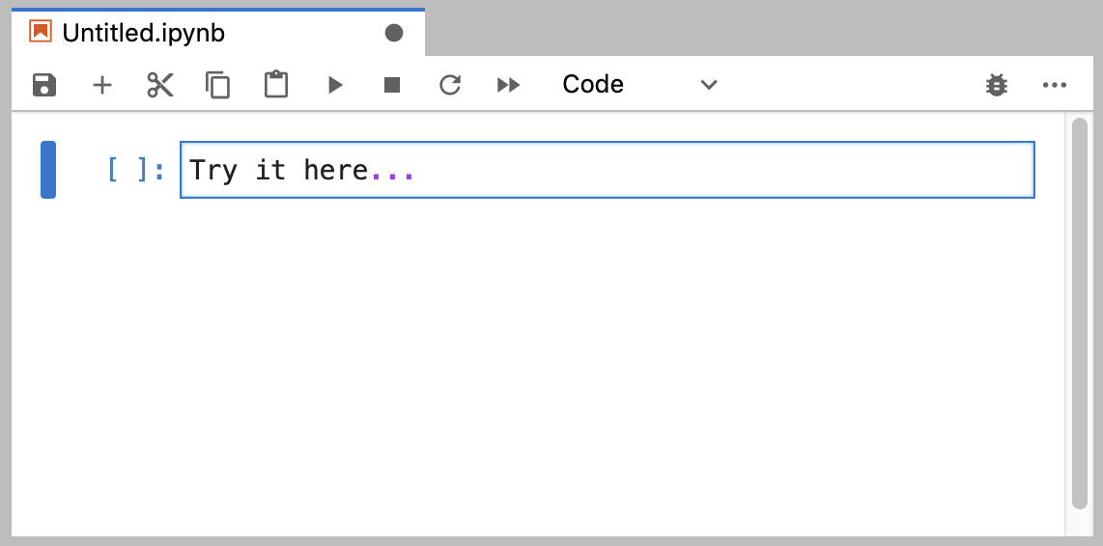
Input / Output
File I/O
Read a file
Write a file
User Input
Read input from command line
Write output to command line
Network (Socket) IO
Read from a socket / network connection
Write to a socket / network connection

Slide 28
Variables Make Use Of Data Types And Structures
A specific string that stores a value during the runtime of a program
Refer to a place in memory where the value is held
Create a new variable like this:
conc = 10

Slide 29
Keywords / Reserved Words
and
exec
not
assert
finally
or
break
for
pass
class
from
print
continue
global
raise
def
if
return
del
import
try
elif
in
while
else
is
with
except
lambda
yield

Slide 30
Data Types
Integer
0, 1, 2, 999
Floating-point number, “Float”
3.14
Boolean
True, False
Character
“a”, “b”, “c”, “A”, “B”, “C”
String (of characters)
“ATCG”

Slide 31
Data Structures
Sequence Data Types
Array (List)
Ordered; duplicates allowed; can change
In python - [1, 2, 3], [ “A”, “B”, “C”]
Tuple
Ordered; duplicates allowed; cannot change
In python – tuple: (“a”, “t”, “g”, “c”);
Sets Data Types
Sets
Unordered; no duplicate elements
In python - Set(['John', 'Jane', 'Jack', 'Janice'])
Mapping Data Types
Hash (Dictionary)
Key / value pair
Unordered; no duplicate keys, can change
In python – { “BRCA1”: “cancer gene” }

Slide 32
Loops
For loop…
Execute a known number of times
While loop
Execute while some condition is met
# Measure some strings: ...
words = ['cat', 'window', ‘student’]
for w in words:
print(w, len(w))

Slide 33
Conditional Statements
Definition
Example(s)
A statement that is true only for certain values (conditions) of the variables or symbols
If conc == 10:
print(“Concentrations is 10 mm”)
else:
print(“Concentration is not 10 mm”)

Slide 34
Operators
Definition
Order of Operators
An object that is capable of manipulating a value or operator
For example, in "1 + 2", the "1" and "2" are the operands and the plus symbol is the operator
Order | Operator | Name | Example
1 | = | Equals | a = b
2 | == | Equals | a == b
3 | != | Not equal | a != b
4 | + | Plus | a + b
5 | - | Minus | a - b
6 | / | Divide | a / b
7 | * | Times | a * b

Slide 35
Functions
Definition
Example
A basic task of a computer, especially one that corresponds to a single instruction from the user.
When an task needs to be performed more then once, it is a good opportunity to convert that code into a function
def multiply(num1, num2):
answer = num1 * num2
return answer

Slide 36
Challenges of Programming
Picking a programming language
Learning a programming language
Knowing which piece of the language to use
Debugging!!!
Remembering what the program does when you come back to it
Keeping track of different programs
Programing requires: Practice, practice, practice!

Slide 37
The biggest mistake I see new programmers make is focusing on learning syntax instead of learning how to solve problems.
- V. Anton Spraul
(Author of “Think Like a Programmer:
An Introduction to Creative Problem Solving”)
https://medium.freecodecamp.org/how-to-think-like-a-programmer-lessons-in-problem-solving-d1d8bf1de7d2

Slide 38
What Should You Do When You Encounter A New Task?
Understand
Plan
Divide
Divide again?
Stuck?
Debug
Reassess
Research
Practice
https://medium.freecodecamp.org/how-to-think-like-a-programmer-lessons-in-problem-solving-d1d8bf1de7d2

Slide 39
If you can’t explain something in simple terms, you don’t understand it.
— Richard Feynman

Slide 40
1. Understand
Know exactly what is being asked
Most hard problems are hard because you don’t understand them (hence why this is the first step)
How to know when you understand a problem?
When you can explain it in plain English
Therefore you should write down your problem, doodle a diagram, or tell someone else about it (or thing… some people use a rubber duck)
https://medium.freecodecamp.org/how-to-think-like-a-programmer-lessons-in-problem-solving-d1d8bf1de7d2

Slide 41
2. Plan
Don’t dive right into solving without a plan. Plan your solution!
Nothing can help you if you can’t write down the exact steps
In programming, this means don’t start programming straight away
https://medium.freecodecamp.org/how-to-think-like-a-programmer-lessons-in-problem-solving-d1d8bf1de7d2

Slide 42
3. Divide
This is the most important step of all!
Do not try to solve one big problem
Instead, break it into sub-problems.
Then, solve each sub-problem one by one. Begin with the simplest.
Once you solved every sub-problem, connect the dots.
Connecting all your “sub-solutions” will give you the solution to the original problem. Congratulations!
https://medium.freecodecamp.org/how-to-think-like-a-programmer-lessons-in-problem-solving-d1d8bf1de7d2

Slide 43
4. Stuck?
Don’t worry though, friend. This happens to everyone!
The difference is the best programmers/problem-solvers are more curious about bugs/errors than irritated.
In fact, here are three things to try when facing a whammy:
Debug
Reassess
Research
https://medium.freecodecamp.org/how-to-think-like-a-programmer-lessons-in-problem-solving-d1d8bf1de7d2

Slide 44
4. Stuck?
Debug:
Go step by step through your solution trying to find where you went wrong. Programmers call this debugging (in fact, this is all a debugger does).
“The art of debugging is figuring out what you really told your program to do rather than what you thought you told it to do.”” — Andrew Singer
https://medium.freecodecamp.org/how-to-think-like-a-programmer-lessons-in-problem-solving-d1d8bf1de7d2

Slide 45
Debugging
Syntax – wrong grammar, i.e., breaking the rules of how to write the language
Forgetting punctuation, misspelling keyword
The program will not run at all with syntax errors
Logic - the program runs but does not produce the expected results
Using an incorrect formula, incorrect sequence of statements, etc.

Slide 46
4. Stuck?
Reassess:
Take a step back. Look at the problem from another perspective. Is there anything that can be abstracted to a more general approach?
Side note:
Another way of reassessing is starting anew. Delete everything and begin again with fresh eyes. I’m serious. You’ll be dumbfounded at how effective this is.
https://medium.freecodecamp.org/how-to-think-like-a-programmer-lessons-in-problem-solving-d1d8bf1de7d2
Notes:
“Sometimes we get so lost in the details of a problem that we overlook general principles that would solve the problem at a more general level. […]The classic example of this, of course, is the summation of a long list of consecutive integers, 1 + 2 + 3 + … + n, which a very young Gauss quickly recognized was simply n(n+1)/2, thus avoiding the effort of having to do the addition.” — C. Jordan Ball

Slide 47
4. Stuck?
Research:
Google it. You read that right. No matter what problem you have, someone has probably solved it. Find that person’ solution. In fact, do this even if you solved the problem! (You can learn a lot from other people’s solutions).
Caveat
Don’t look for a solution to the big problem. Only look for solutions to sub-problems. Why? Because unless you struggle (even a little bit), you won’t learn anything. If you don’t learn anything, you wasted your time.
https://medium.freecodecamp.org/how-to-think-like-a-programmer-lessons-in-problem-solving-d1d8bf1de7d2

Slide 48
Practice
Don’t expect to be great after just one week. If you want to be a good problem-solver, solve a lot of problems!
Practice. Practice. Practice. It’ll only be a matter of time before you recognize that “this problem could easily be solved with <insert concept here>.”
https://medium.freecodecamp.org/how-to-think-like-a-programmer-lessons-in-problem-solving-d1d8bf1de7d2

Slide 49
Practice
How to practice? There are options out the wazoo!
Practicing “micro problem-solving.” For example, Peter Thiel plays chess, and Elon Musk plays video-games.
So, what you should do is find an outlet to practice. Something that allows you to solve many micro-problems (ideally, something you enjoy).
For example, try coding challenges. Every day, try to solve at least one challenge
https://medium.freecodecamp.org/how-to-think-like-a-programmer-lessons-in-problem-solving-d1d8bf1de7d2

Slide 50
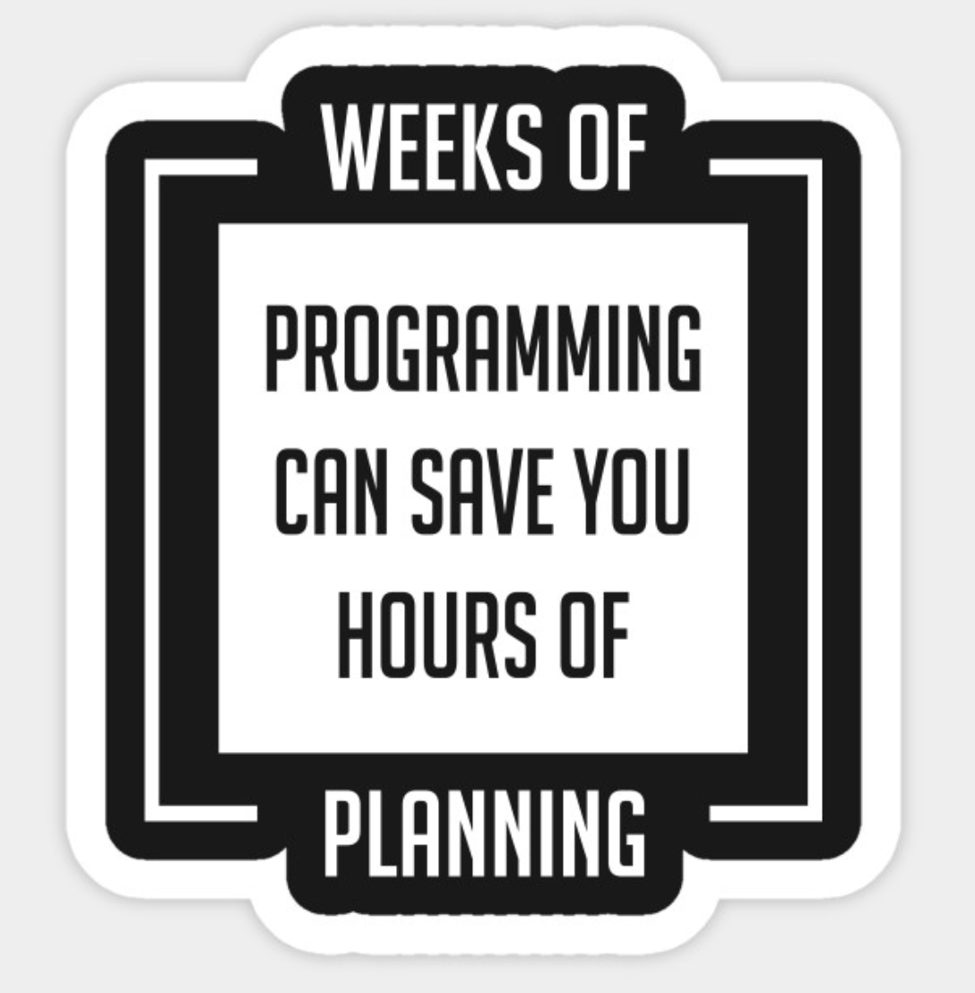
How To Write A Program
Think about the problem you want to solve
Outline the steps necessary to solve the problem
This is pseudocode
This is also your algorithm
Convert your pseudocode to real code
We will be writing our code in the python programming language
Run your code
Test your program

Slide 51
Think About The Problem You Want To Solve
Input / Output << Are there any input or output to your program?
Variables << Will you need to store any information?
Data Structures << How will you store your information?
Loops << Are there any loops in your program?
Conditionals << Are there any conditions?
Math operations << Are there any math operations?
Functions << are there tasks that are repeated? In a loop?

Slide 52
How Do We Convert Pseudocode to an Actual Program?
Write your own code, all from scratch (…rarely)
Write your own code but use packages (..often)
Adapt code written by someone else (…often)

Slide 53
Writing Our Program
Source code
Written in plain text
Write in
Text editor
Integrated development environment (IDE)
Jupyter Notebook
#!/usr/bin/python
# “This programs sums numbers given to it”
value = 1
sum = 0
print('Enter Numbers to add to the sum.')
print('Enter 0 to quit.')
while value != 0:
print('Current Sum:', sum)
a = float(input('Number? '))
sum = sum + value
print('Total Sum =', sum)

Slide 54
Code Is Read More Often Then It Is Written!

Slide 55
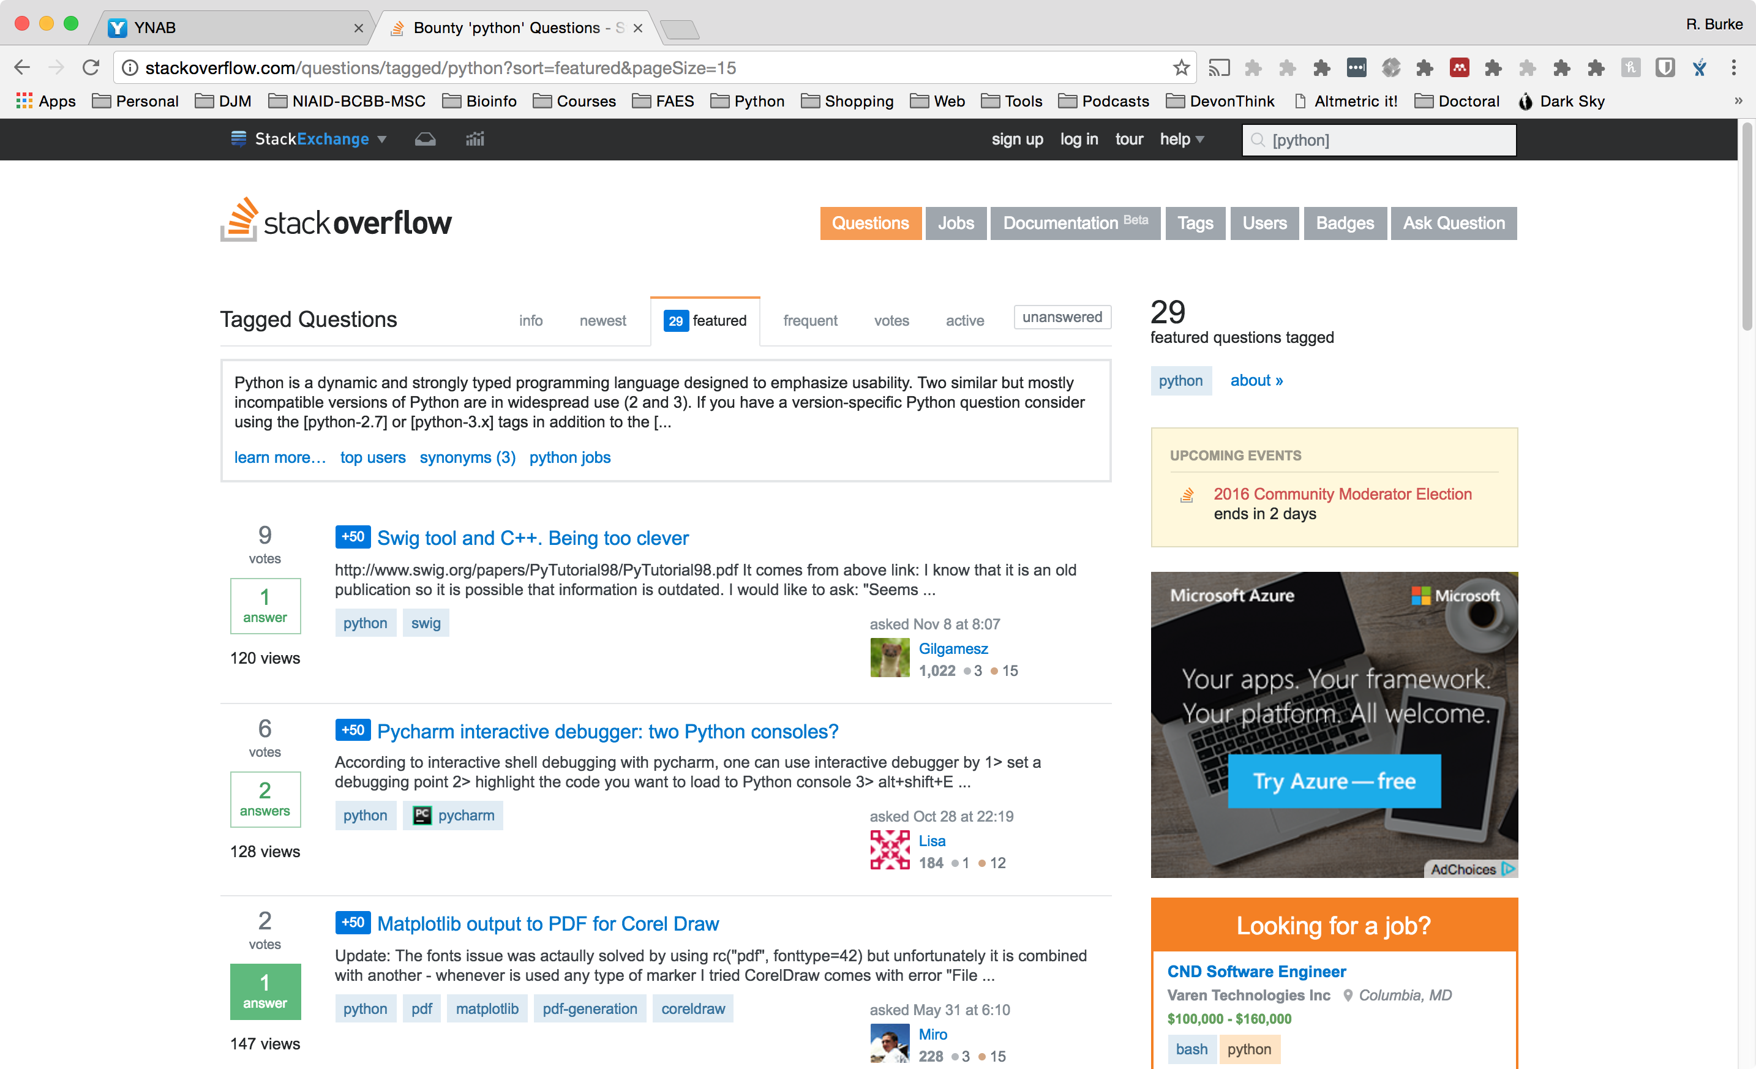
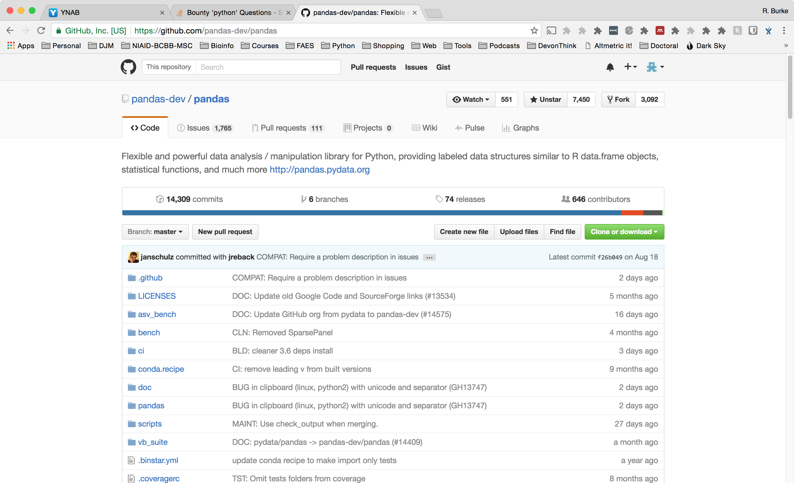
Where To Find Package or Code?
Your Previous Code
Other lab members code
Google Search
StackOverflow
GitHub (Open source, source code repository)
Programing language repository (python – pip, conda; R – cran)

Slide 56
Pseudocode Experiment

Slide 58
Learning Objectives
To familiarize you with computer programming, programming languages, scientific packages
Enable you to communicate better with programmers, bioinformaticians
Critique existing source code for your use
Assess which language that bests fits your needs
Facilitate you becoming a reproducible scientist
Notes:
Update

